Slide 1
Smoothing Reactor
Lahore Converter Station
Master Name: Mr Wang Tong lu
By Rana Abdul Rehman

Slide 2
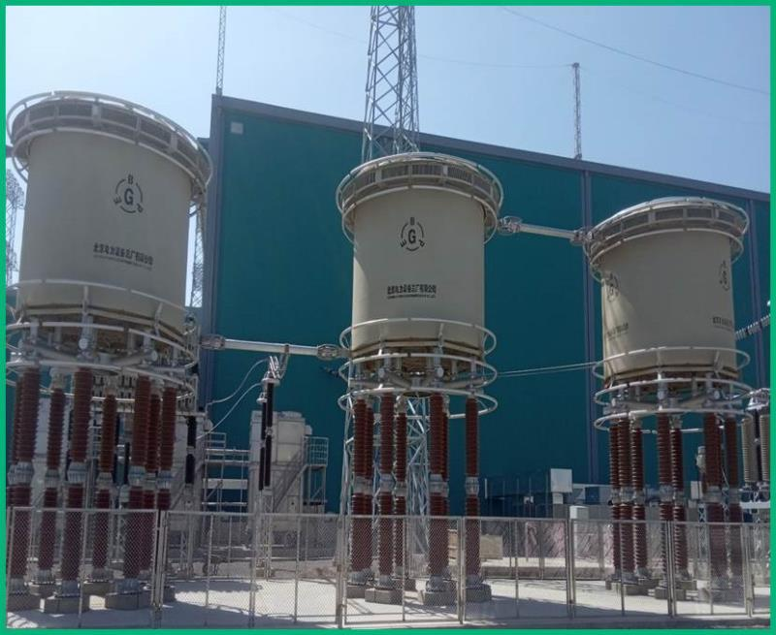
Smoothing Reactor:
It’s the series connected device inserted in the DC yard for protection of the converter valves. It is designed as a linear reactor and is connected Two on line side and one on valve side, two connected on neutral side or at intermediate location and one on valve side.

Slide 3
Function of Smoothing Reactor:
To Smooth of the DC ripples. DC ripples are the unwanted variation in the DC voltages. They occur because of the incomplete conversion of AC to DC voltage.
To reduce the incidence of the commutation failure in inverters cause by dips in the ac voltage at the converter bus.
To reduce the harmonic voltage and current in the DC line.
To reduce the requirement of the AC and DC filter.
To reduce the current and voltage transient during sudden changes in the power flow.
To reduce the crest of the short circuit current in the DC line there by reducing the stress on the converter valves.

Slide 4
Working of DC Smoothing Reactor:
Smoothing reactor functions as the pure inductance.
Current “Id” through the smoothing reactor do not change instantaneously. Under Changing current condition the EMF is induced in the reactor coil.
e= L *di/dt
This EMF opposes the rate of change of current. The current change takes finite time of the orders of a few micro or milli seconds.
This principal gives the smoothing effect to the DC waveform.
On neutral line the benefit of reactor is it also helps to clear the ground faults with the help of converter control.

Slide 5
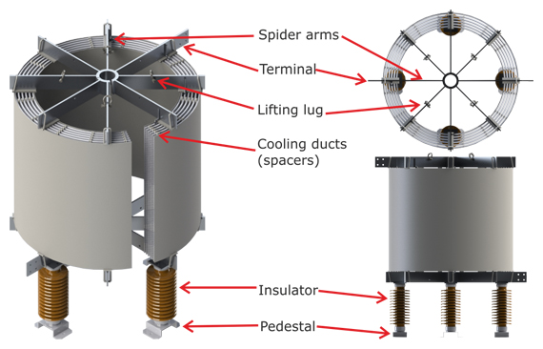
Reactor Configuration:
Reactor body Consist of Spider Arms
Lifting lugs use to lift the Smoothing reactor
Cooling ducts are there to provide air circulation in the tank.
Insulator are there to isolate the pedestal and Smoothing reactor.
Pedestal make the reactor vibration free and strong foundation structure.

Slide 6
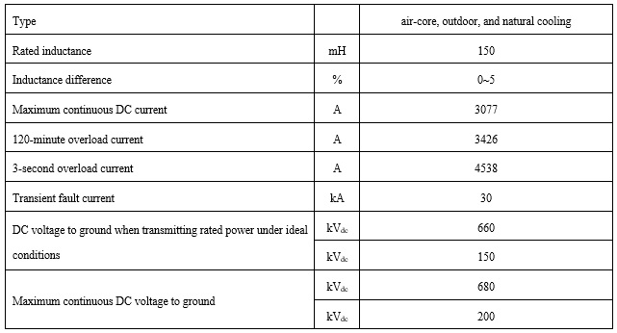
Sizing of the Smoothing Reactor
Taking all design aspects above into account, the size of smoothing reactors is often selected in the range of 100 to 300 MH for long-distance DC links and 30 to 80 MH for back-to-back stations.
It should smoothen the DC voltage and current waveform to acceptable limit.
It should be insure the flow of DC current when the delay angle is close to 90 degree.

Slide 7
Reactor Design Alternatives
There are basically two types of reactor design:
■ Air-insulated dry-type reactors
■ Oil-insulated reactors in a tank
We are using here Air-insulated dry-type reactor.
The reactor type should be selected taking the following aspects into consideration:
■ Inductance
■ Costs
■ Maintenance and location of spare units
■ Seismic requirements

Slide 8
Operation procedure of Reactor
During normal operation, the sound and vibration of the reactor should be normal.
Monthly charged infrared temperature measurement of the reactor body and its electrical connection parts.
The surface of the reactor should be cleaned regularly, and if there are discharge marks or paint peeling off on the surface, as well as flow
(dripping) glue and cracks, it should be handled in time

Slide 9
Operation Routine Checks:
Regularly check whether there are birds nesting on the reactor or insulating support.
Regularly check for abnormal sounds, loose bolts or other parts.
Regularly check whether there are discharge marks on the outer surface of the reactor.
Regularly check whether there are obvious large cracks in the sound absorption tube in
the middle of the reactor.
Regularly check the outer surface of the reactor for obvious abnormal discoloration.
Regularly check the quality of the RTV coating on the surface of the sound cover.
Regularly check the overall corona ring installation for looseness or displacement. Use an
infrared imager to check the overall reactor for hot spots

Slide 10
Thank you

